Slide 1

G2M CASE STUDY
Virtual Internship
Presentation By: Ebaghae Wendy Imhanlahimi
March 20th, 2023.

Slide 2
Background – G2M(cab industry) Case Study
XYZ is a private firm in the USA. It plans to invest in the cab industry. XYZ wants to understand the market to know which cab company to invest in.
Objective: Provide actionable insights to help XYZ identify the right company to invest in.
The analysis comprises of the following parts;
Data Exploration
Identifying the most profitable cab company.
Viewing cab use in relation to demographic features.
Recommendations

Slide 3
Data Exploration
Two tables were used for analysis; Cab_Data1.csv and City_Data.csv.
City _Data has 4 features (1 derived) and 20 observations.
Cab_Data1 has 13 features (3 derived) and 359391 observations.
Cab_Data1 is the main data used for analysis derived by joining features from the following datasets:
Cab_Data.csv, City_Data.csv, Customer_ID_Data.csv and Transaction_ID_Data.csv.
The data spans the period of 31/01/2016 to 31/12/2018.
Assumptions:
Profit from rides is calculated using the formula; 'Price charged – Cost of Trip', keeping other factors constant.
Percentage of cab users is calculated using the formula; '(Users/Population) * 100'.
Cab Users ages are grouped as follows; Post teen adults(18yrs - 19yrs), Young adult(20yrs - 30yrs), Adults(30yrs - 45yrs), Middle-aged adults(45yrs - 60yrs) and Elder(60yrs and above).
Cab Users income groups based on monthly income are as follows; Lower middle income earner($1026 - $3995), Upper middle earner($3996 - $12,375), High income earner ($12,376 - above).
Outliers present in the 'Price Charged' feature are not treated as outliers in the analysis.
Users feature in City_Data comprises of all cab users in a given population inclusive of yellow and pink cab companies.

Slide 4
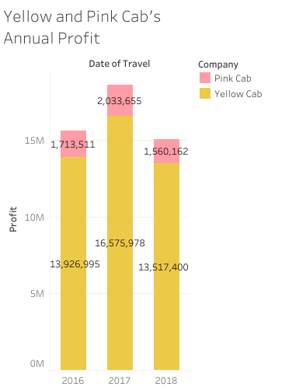
Profit Analysis
The bar chart (Yellow and Pink Cab's Annual Profit) shows the annual profit of yellow cab and pink cab from 2016 to 2018.
The bars show that yellow cab makes more profit (about 8 times more) than pink cab on a yearly basis.

Slide 5
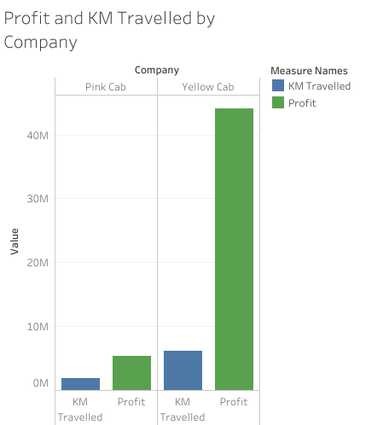
Profit Analysis
The bar chart (Profit and KM Travelled by Company) shows the total kilometers travelled and total profit made by both cab companies over the period covered by the data.
Yellow cab travelled more kilometers than Pink cab .
Yellow cab made much more profit on the kilometers it travelled than Pink cab made on the kilometers it travelled.

Slide 6
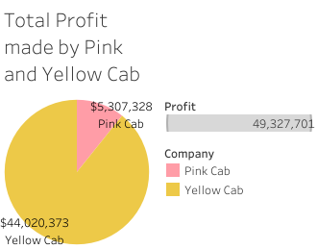
Profit Analysis
The pie chart shows total profit made by both cab companies.
The total profit is $49,327,701 for the years 2016 to 2018.
Yellow cab made $44,020,373 (89%) of the total profit.
Pink cab made $5,307,328 (11%) of the total profit.

Slide 7
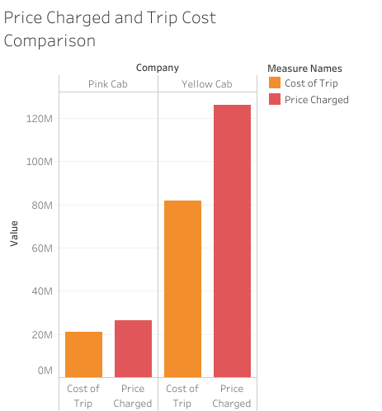
Profit Analysis
The bar chart shows the price charged side by side with the trip cost for each company.
Yellow cab incurred more cost than pink cab, this is due to the fact that it travelled more kilometers and had more transactions.
Yellow cab's price charged is far greater than pink cabs price charged showing great profitability.

Slide 8
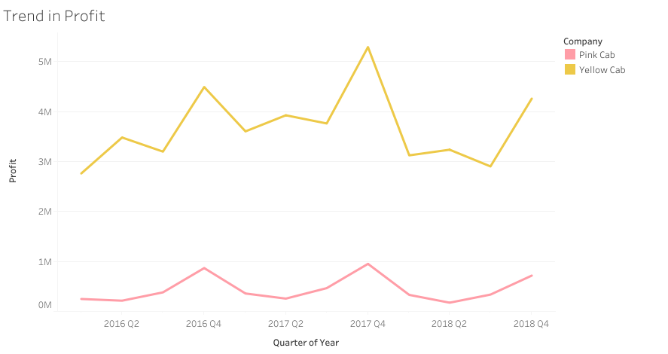
Trend in Profit
Yellow cab has high profit overtime.
Peak profit for both cab companies is in Q4 (festive seasons).
Profit drops for both companies by Q1 and starts to peak by Q2.

Slide 9
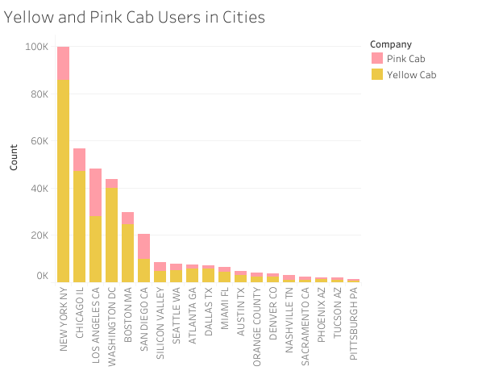

Slide 10
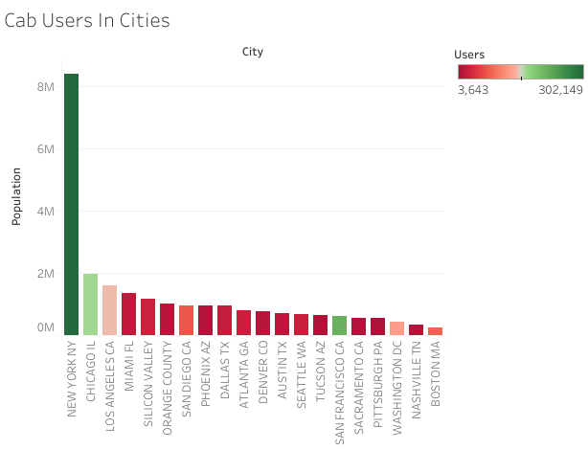
The bar plot shows the population in various cities.
The color represents cab users in the population.
Green shows high amount of cab users, pink shows medium and red shows small amount of cab users.
New York, Chicago and San Francisco have the highest amount of cab users .

Slide 11
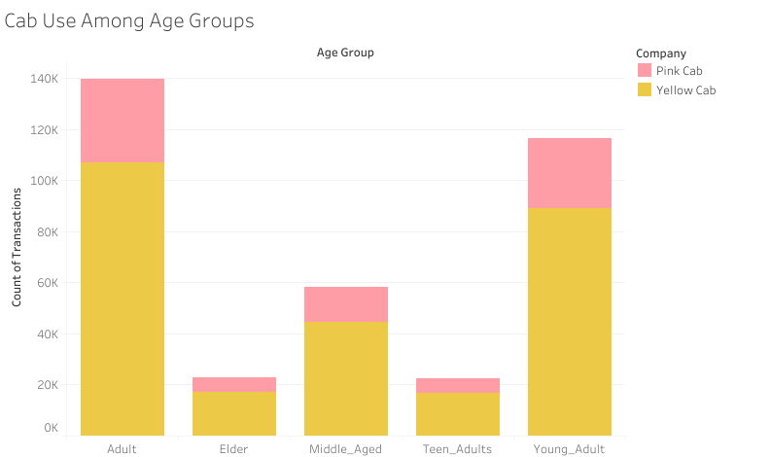
Adults use cabs the most.
Teenagers and elders use cabs the least.
Yellow cab is patronized more than Pink cab across all the age groups.

Slide 12
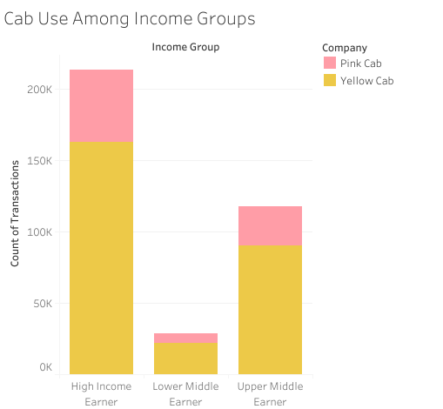
High income earners use cabs the most.
Lower middle earners use cabs the least.
Yellow cab is Patronized more than Pink cab across all the income groups.

Slide 13
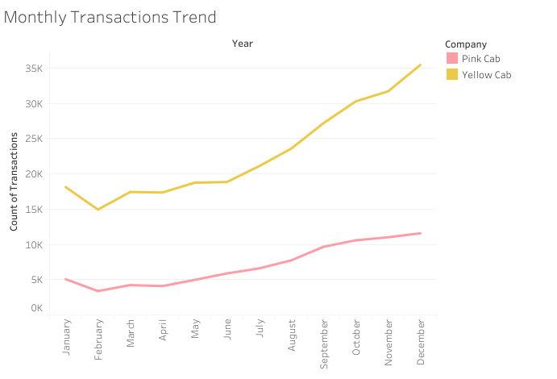
Cab use peaks in the fourth quartile of the year and drops in the first quartile.

Slide 14
Recommendations
From the data, we can see that Yellow cab company is patronized more than pink cab company, it is recommended that investment can be made in Yellow cab company.
The data also showed that overtime, profit for the yellow cab company has maintained a stable trend and has been high, it thus shows that Yellow cab company has great potentials and would be a good investment option.
The profit analysis shows that Yellow cab makes greater profit than pink cab company in its transactions as can be seen from the various charts plotted.
The data as shown in 'Yellow and Pink Cab users in Cities' showed that cab is used most in highly populated cities like New York. It is recommended that investments be made in the cab industry in populous cities.
The bar chart 'Cab Usage Among Income Groups' shows that high income earners use cabs the most, while low middle earners use cabs the least. This income group classification can serve as target audience in the cab industry for campaigns depending on the goals of the campaign.

Slide 15
Recommendations
The data depicted in the 'Cab Users in Cities' bar plot shows that New York, San Francisco and Chicago have the highest percentage of cab users. However, we observe that San Francisco which presents a great potential for the cab industry has not been tapped by either the yellow cab or pink cab industry (it is not included in any transactions). It is recommended that investments can be made in the cab industry in San Francisco as the city has a high percentage of cab users in general.
The bar chart 'Cab Usage Among Age Groups' shows the adult age group as the age group with the highest cab use, accompanied by the young adults age group. The teen adults been the age group with the lowest patronage. It is recommended that certain age groups can serve as target audience in the cab industry depending on the goals of the campaign.

Slide 16
Conclusion
After analyzing and studying the data on yellow and pink cab companies, it can be seen that Yellow cab company from its transactions and profits overtime has proven to have great potential in the cab industry.
From the results of our analysis, it is thus highly recommended that investments can be made in the Yellow cab company.

